Slide 1
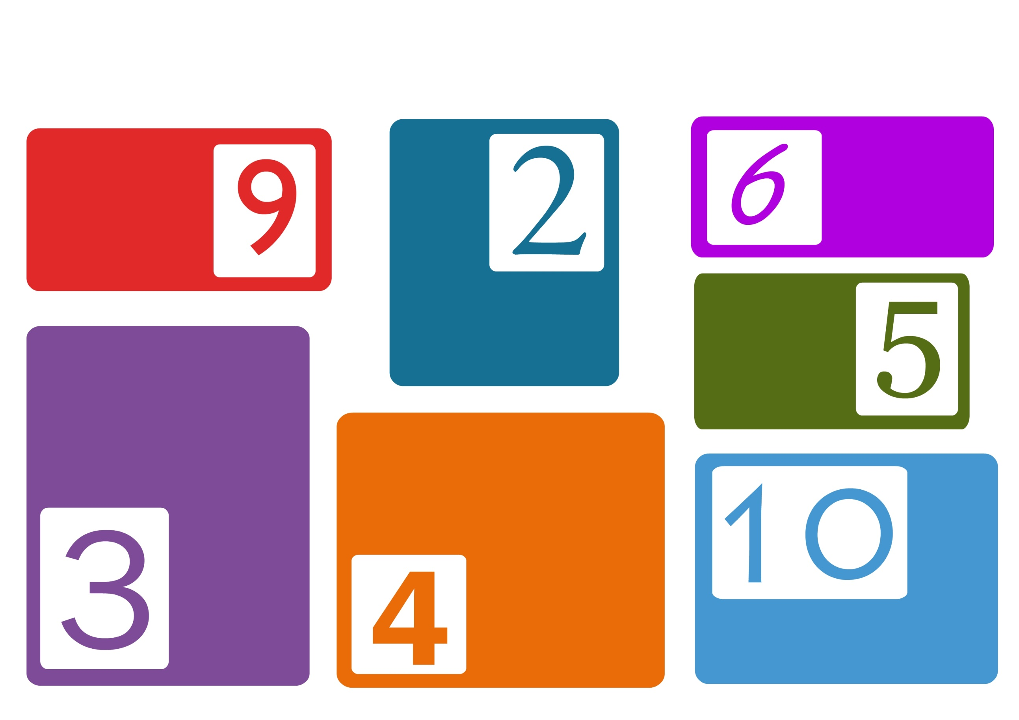
How to decide if a number is a multiple of…
The number is
a multiple of
2 and 3.
The sum of the number’s digits is a multiple of 9.
The number is even, i.e. ends with
2, 4, 6, 8 or 10.
The number ends with
5 or 0.
The sum of the number’s digits is a multiple of 3, e.g. 8142 is a multiple of 3 as 8 + 1 + 4 + 2 = 15
is a multiple of 3.
Half of the number is even.
(b) The last two digits of the
number is a multiple of 4.
The number ends with 0.

